Slide 1
Intro to Linux
Ian F, Hayley P, James R
Notes:
Pre-intro:

Slide 2
Day 1
https://youtu.be/URVS4H7vrdU

Slide 3
Why do I want to learn Linux?

Slide 4
Objectives
Get working knowledge of Unix/Linux
Get some practical experience of using Linux
Know where to go to keep learning
Not:
Learn how to use every program in the world (e.g. we won’t cover git, python, R, gdb, docker, tex, …)
The only source of information you’ll ever need

Slide 5
Structure
Day 1 am
Introduction and getting started
Regular expressions
The file hierarchy
Day 1 pm
Looking at files
Pipelines
sed and awk
Day 2 am
Shell scripts
Processes and job control
Day 2 pm
Users and security
Setting up your environment
Installing software

Slide 6
General stuff
Please ask questions at any time
There will be exercises throughout the day, varying in difficulty
Work at your own pace - we expect varying levels of experience

Slide 7
What is a computer?
●
Start with a collection of simple circuits (add, compare, read/write memory, etc.), and switches to choose what instruction to execute
Clever idea: store the program in memory and get the computer to switch itself
Manipulating the program counter allows programs to loop
Since computer circuits are fast, this makes writing and running the program faster than computing the result by hand

Slide 8
What is Unix?
●
Unix is a family of operating systems, first appearing in 1969
It is still very popular - Linux, Android, macOS are based on it
Linux is a free, open-source family of Unix-based OSs
Many distributions of Linux are available - popular ones include Ubuntu, CentOS, Debian and openSUSE
Around 96% of all servers on the internet are powered by Linux (W3Cook 2015), as are all supercomputers in the TOP500

Slide 9
What is Unix?
●
When we say ‘Unix’ we also mean ‘manipulating data using small component programs’ - any OS could do this, but the Unix environment is designed with this in mind - see https://en.wikipedia.org/wiki/Unix_philosophy
In this sense, Unix competes more with Web apps than with e.g. Windows
Notes:
Like all good software cults, adherents to the Unix philosophy despair that people aren’t doing it properly

Slide 10
Getting started
●
You should have access to a Linux virtual machine
From the desktop, you can launch normal window-based programs
Chromium or Firefox are typical internet browsers
Office suite is usually an open-source version like LibreOffice, which can handle the usual MS Office file formats (mostly)
Terminal provides command-line interface to the computer
This course will focus on interacting with Linux via the terminal

Slide 11
The terminal
●
The terminal is one of the earliest interfaces to a multi-user computer. It is still used because:
A text-based interface is powerful
Automation is straightforward, because files can contain the text of the commands
By default, users enter a line of text (a “command line”) which the computer then processes, and any output is displayed on-screen.
Notes:
https://ux.stackexchange.com/questions/101990/why-are-terminal-consoles-still-used

Slide 12
Regular expressions
■
Command | Outcome
grep -E '^[0-9]*$' file | Output lines containing only digits
Remember:
wrap regexes in single quotes to protect special characters
grep -E recognises more regex characters by default
man grep describes regular expressions and many options
Regex | Meaning
a | The letter a
. | Any single character
[abc] | Exactly one of a, b, or c
^ and $ | Start of string, end of string
exp* | Any number (including 0) of the preceding expression
e1|e2 | Either of the expressions

Slide 13
Selecting lines with grep
■
grep is a powerful command-line program used to select lines of a file matching a regular expression:
bash-4.4$ grep -E 'u.n.i.[xy]$' /usr/share/dict/words quantify quantity
grep has many options, e.g. -c for counting matches, -o for printing only the parts of the line that match, -v for printing lines that don’t match (see the man page for full details)

Slide 14
Regular expressions
■
Regular expressions (regex) give a syntax for patterns that match strings, originating in formal language theory in the 1950s
Many Unix tools support regular expression matching, along with several programming languages
Notes:
https://en.wikipedia.org/wiki/Regular_expression

Slide 15
Matching single characters
■
Many characters simply match themselves - for example letters, digits, _, %, #, …
The character . is a wildcard, matching any single character
To match one of a set of characters, enclose them in square brackets - for example [abc] matches one of the characters a, b or c
Square brackets can also contain ranges - e.g. [0-9] to match any digit. A set can be complemented with the caret - e.g. [^0-9] to match any non-digit
A character that would otherwise have a special meaning can be matched literally by escaping it with a backslash - e.g. \., \[, \\, or using a set - e.g. [.], []]
Notes:
The rules for putting special characters inside sets have a lot of edge cases - read the grep man page for details

Slide 16
Repetition
■
The power of regular expressions comes from the repetition operator, *, which causes the preceding expression to be matched zero or more times
For example, [abc]* matches any string that contains only letters a, b, or c
Additional repetition operators include: ? Match zero or one times (i.e. an optional match) + Match one or more times {5} Match 5 times {5,} Match at least 5 times {5,10} Match at least 5 times, but not more than 10 times
Notes:
These can be chained together, so that e.g. [0-9]{5}+ matches a run of 5, 10, 15, etc. digits

Slide 17
Concatenation
■
Concatenated regular expressions match consecutive parts of a string:
hello[123] matches hello1, hello2 or hello3
To repeat a concatenated regular expression, enclose it in round brackets:
hello+ matches hello, helloo, hellooo, etc.
(hello)+ matches hello, hellohello, hellohellohello, etc.

Slide 18
Alternation
■
To match either of two regular expressions, join them with the pipe character |:
hello|world matches hello or world
0|[1-9][0-9]*|0x[0-9a-f]+ matches either a decimal or hexadecimal number
Notes:
It is tempting to use [0-9]+ to match decimal numbers, but many programming languages interpret numbers with a leading 0 as octal

Slide 19
Other special characters
■
^ matches the start of the string, $ matches the end of the string - these are convenient in grep and other tools where otherwise the regex may match anywhere within the string
For example the string hello123 contains a match for [0-9]+ and [0-9]+$, but not ^[0-9]+$
\<, \>, and \b match the beginning, end and edge of a word respectively, where a word consists of letters, numbers and underscores

Slide 20
Backreferences
■
Backreferences allow repetitions of the text that has been matched (as opposed to repetitions of the regular expression). The n^{th} backreference refers to the text within the n^{th} pair of round brackets, counting open brackets 1-up:
(Hello|World)\1 matches HelloHello or WorldWorld (but not HelloWorld)
([0-9])\1* matches numbers all consisting of the same digit
(.)(.)(.)\3\2\1 matches 6-character long palindromes

Slide 21
grep options
■
Beyond choosing the regular expression, the output of grep can be controlled by providing options, which are listed in the man page. Some common ones include:
Option | Outcome
-E | Match an extended regular expression
-F | Match a fixed string (i.e. all characters match literally)
-c | Display only the number of lines that match
-i | Match case-insensitively
-n | Display the line number of matched lines
--color | Highlight the matched portion of the line
Notes:
Without -E, the regex characters +, ?, |, (), and {} instead match literal characters, and must be preceded by a backslash to take their extended meanings

Slide 22
Exercises
■
The file /usr/share/dict/words contains dictionary words. Find words that: - contain only letters a-g inclusive - contain the substring ought - contain all the vowels in order - alternate consonants and vowels, and are at least 12 letters long
Construct regular expressions that match: - a decimal number written with commas separating groups of 3 digits (e.g. 100,000 or 16,777,216 or 30) - a date between 01/01/2000 and 31/12/2019 Test your regular expressions by counting matches in files numbers and dates at https://github.com/itlfiles/exercises
Notes:
To download test files, run this command:
wget https://raw.githubusercontent.com/itlfiles/exercises/main/{numbers,dates}

Slide 23
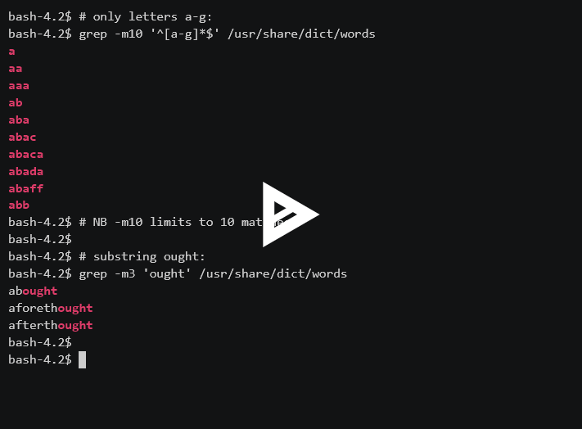
Exercises (solutions)
■
See demo:

Slide 24
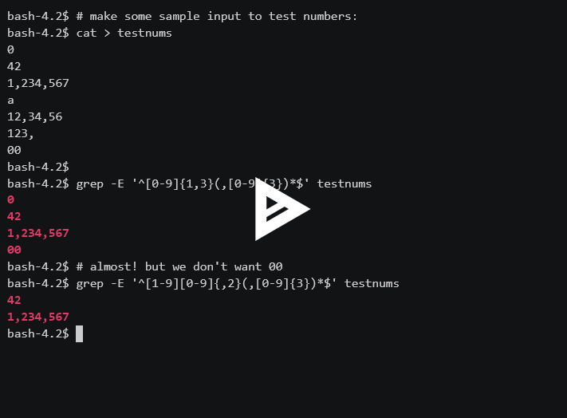
Exercises (solutions)
■
See demo:

Slide 25
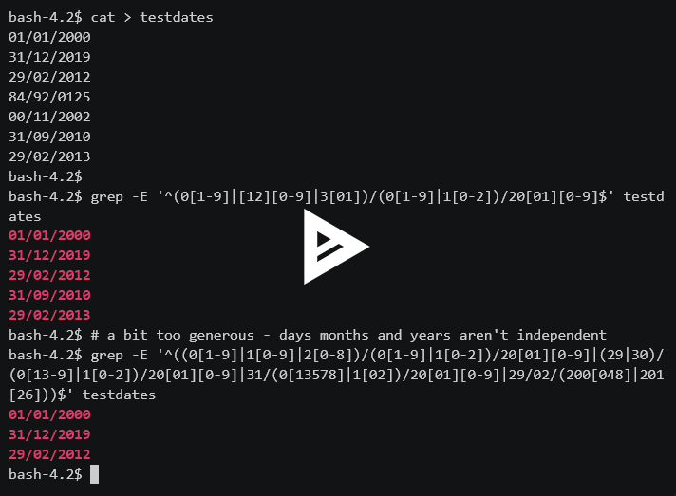
Exercises (solutions)
■
See demo:

Slide 26
Basic interaction
●
Command | Outcome
pwd | Display current directory
ls | List files in current directory
ls ~ | List files in home directory
ls /file/path | List files in path specified
cd /file/path | Change directory to new file path
cd .. | Change directory to parent directory
cd | Change directory to home directory
<up arrow> | Edit previous command
Remember:
tab once to complete, tab twice to get list of possibilities
directories in paths are separated by forward slashes (/)

Slide 27
The shell
●
Basic command-line syntax is program argument …
The shell (bash) is responsible for finding the program and splitting the line you write into arguments:
bash-4.4$ ls ~
file1 file2 file3
bash-4.4$ ▒
Q W E R T Y U I O P A S D F G H J K L
Z X C V B N M
bash
Linux
ls ~
execve(“/bin/ls”, [“ls”, “/home/username”])
ls
Notes:
You can see the system calls that a program makes to Linux (including the execve) by running e.g. strace ls ~ (this picture is not quite accurate - the bash process in fact instructs Linux to make a copy of the bash process, then the copy runs execve() to change itself into ls)

Slide 28
bash features
●
bash tries to make it easy to write commands:
Command history is stored, and can be traversed using the up and down arrows. Lines in the history can be edited and rerun
When writing a file or directory name, you can press Tab after writing the first few characters to fill in the rest, assuming there is only one option. To see all options available, press Tab twice
Notes:
These features are part of the readline command-line editing library, and are also available in other programs (e.g. the Python interpreter)

Slide 29
The file hierarchy
●
Files are stored in a tree of directories.
/
/bin
/home
/tmp
/usr
/bin/cat
/bin/ls
/home/user
/usr/bin
/usr/share
/home/user/myfile
/home/user/mydir
/home/user/mydir/myfile

Slide 30
Navigating directories
●
The shell (actually, each program) has a notion of the current working directory - paths that do not begin with / refer to items relative to this directory
Use pwd to print the working directory, and cd to change directory
bash-4.4$ cd /usr/local bash-4.4$ ls bin etc games include lib man sbin share src bash-4.4$ cd bin bash-4.4$ pwd /usr/local/bin

Slide 31
Relative paths
●
Every directory contains two special directories:
. (dot), which refers to the directory
.. (dotdot), which refers to the parent directory
This allows relative paths to refer to any file in the filesystem
ls means ls .
Notes:
Run ‘man path_resolution’ for full details

Slide 32
Disks
◆
Originally two disk setup was common, with /usr on a separate disk to the rest of the system
Mount points allow the hierarchy to be stored across multiple physical filesystems, with little effect on the users
Mounts are used to set disk quotas (e.g. per user) and to make filesystems available on multiple computers

Slide 33
inodes
⧫⧫
/
inode 2
/bin
inode 393220
/home
inode 16385
/tmp
inode 2
/usr
inode 2
/bin/cat
inode 393239
/bin/ls
inode 393290
/home/user
inode 22381
/usr/bin
inode 4748
/usr/share
inode 4751
/home/user/myfile
inode 31144
/home/user/mydir
inode 281433
/home/user/mydir/myfile
inode 281435
Notes:
You can see the inode number of a file with ‘stat’ or ‘ls -i’ (note that to see the inode of a directory you may need e.g. ‘ls -i -d /’)

Slide 34
Disk layout
⧫⧫
inodes (metadata)
File contents
File contents
File contents
File contents
Notes:
‘df’ will show how much of the file contents space has been used; ‘df -i’ will show how many inodes are available

Slide 35
Exercises
●
Move to the /bin directory. This is a directory that contains core system programs (such as ls and bash) Check that you’ve moved successfully by running pwd List all the files in this directory Move back to your home directory (how many ways can you find to do this?) Run history to see all the commands you’ve run
For each of the following paths, can it be listed with ls? If so, what is the shortest absolute path it refers to? ~/../ /usr/bin/../../bin /bin/././/ls /~ /bin/ls/ (◆ Harder exercise: /bin/../usr/bin)

Slide 36
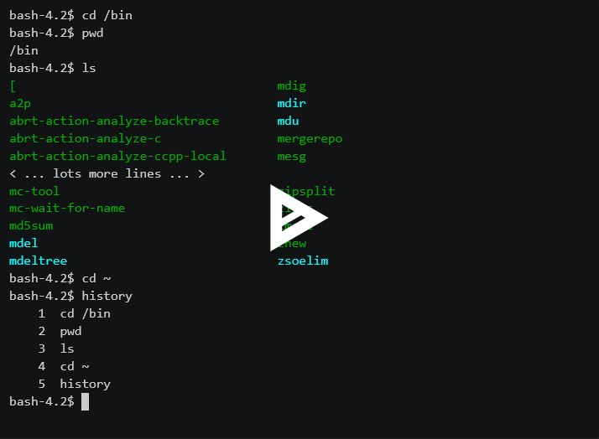
Exercises (solutions)
●
See demo:

Slide 37
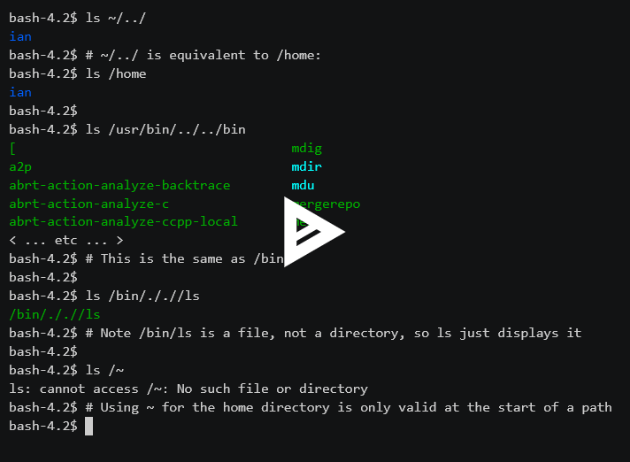
Exercises (solutions)
●
See demo:

Slide 38
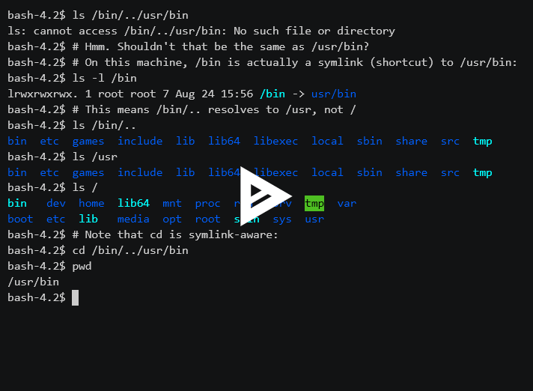
Exercises (solutions)
◆
See demo:

Slide 39
Looking at files
●
Command | Outcome
file myfile | Description of file type
cat myfile | Output the contents of the file
cat file1 file2 | Output both files (concatenated)
head myfile | Output first 10 lines of the file
tail * | Output last 10 lines of each file in the current working directory
less myfile | View a file one page at a time (q to exit)
xdg-open myfile | Open a file using a default viewer
xxd myfile | Output hexdump of file
Remember:
tab once to complete, tab twice to get list of possibilities
many programs can work on multiple files (not xdg-open or xxd)
wildcards allow you to specify multiple files efficiently

Slide 40
Files
●
Files contain a sequence of bytes (8-bit values). The meaning of the bytes is imposed by the user in choosing particular programs to read the file
For example, files are commonly used to store printable text. The most widely used mapping from bytes to characters is ASCII, which specifies that e.g. the letter ‘A’ is represented by the byte value 65
Many Unix programs process text files as a sequence of lines. By convention, lines are terminated by the ASCII newline character (byte value 10), including at the end of the file.
Notes:
Run ‘man ascii’ to see the ASCII character set. Note that ASCII only defines characters for bytes with values 0-127

Slide 41
Reading files
●
file is a program that attempts to infer the format of the bytes inside a file:
bash-4.4$ file /etc/passwd /etc/passwd: ASCII text
cat outputs the contents of a file (or multiple files)
less is a file viewer that allows scrolling through the file (rather than printing it all immediately like cat). It is also capable of reading some compressed or archived file formats by interpreting the filename
Notes:
/etc/passwd is a system file that controls where users’ home directories are and what shell they use

Slide 42
Do more with less
●
less is the first program we’ve used interactively (apart from bash itself)
Press h to see the commands less understands. These include:
Command | Outcome
q | Quit less (or man)
g | Show the start of the file
G | Show the end of the file
100g | Jump to line 100
-N | Display line numbers
Command | Outcome
/mytext | Search for text in the file
n | Jump to the next match
N | Jump to the previous match
:n | Switch to next file
:p | Switch to previous file
Notes:
A lot of this syntax is to mimic the editor vi

Slide 43
Programs are files too
■
bash-4.4$ which ls /bin/ls bash-4.4$ which cat /bin/cat bash-4.4$ cat /bin/ls ELF>�H@@�@8 @@@@@@��88@8@@@D�D� ����a��ap ���a��TT@T@DDP�tdppApA,,Q�tdR�td����a��a/lib64/ld-linux-x86-64.so.2GNUGNU�*CLO�Z�-�4� (more output omitted)
Outputting binary files can affect the behaviour of the terminal - you can (sometimes) get back to normal by running reset
Notes:
For a more useful view of executable files, try ‘objdump -d /bin/ls’. Disassembling Unix programs is for the most part allowed, but you might want to check licensing before doing it

Slide 44
Hexadecimal
■
Arbitrary byte values are commonly displayed in hexadecimal (base 16). You may see hexadecimal (or hex) values prefixed with ‘0x’, so that e.g. ASCII newline is byte value 10 (decimal) = 0x0a (hex)
xxd outputs a ‘hexdump’: positions and bytes in a file in hex, together with printable characters where possible - e.g.
bash-4.4$ xxd /bin/ls 00000000: 7f45 4c46 0201 0100 0000 0000 0000 0000 .ELF............ 00000010: 0300 3e00 0100 0000 5058 0000 0000 0000 ..>.....PX...... 00000020: 4000 0000 0000 0000 a003 0200 0000 0000 @............... ...

Slide 45
Lunch

Slide 46
Recap
Notes:
Millionaire game https://docs.google.com/presentation/d/1ndTXXnpmTT8RH1LtKiOalJzx3zHtrhdp7nj5HXkjZs8/edit?usp=sharing

Slide 47
Globbing
●
Many programs can run on multiple files: ls, cat, file, less, head, tail, …
Globbing allows the use of wildcard characters to expand to multiple filenames:
? matches any single character
* matches any string, including the empty string
[0-9] matches any digit; [abc] matches exactly one of a, b, or c
For example, less *.txt will view all files in the current directory with names that end with ‘.txt’. Similarly file /bin/* /usr/bin/* will display the type of all files in directories /bin and /usr/bin

Slide 48
Editing files
●
Command | Outcome
gedit myfile | Edit the contents of a (possibly new) file
mv myfile newname | Rename a file (also works with full paths)
cp myfile /dest/ | Copy a file into a different directory
rm myfile | Removes a file
cmd > myfile | Creates a file from the output of cmd
mkdir mydir | Create an empty directory
rm -r mydir | Removes a directory and its contents
chmod 600 myfile | Change the permissions of myfile (here limiting access to the file owner)
Remember:
think before you rm!
think especially before you rm -r *
man shows the options a program accepts
press q to leave the man page (like less)
Notes:
Don’t worry if there’s lots of info, we’ll go through each in more detail now.

Slide 49
Creating files
●
You can create text files with a variety of programs called editors - gedit is simple to use if you don’t have a preference
Other editors include emacs, vim, nano
Run gedit filename to create and/or edit the contents of filename
cp oldpath newpath copies a file to a new location (even a different directory) - alternatively cp oldpath newdir copies a file to another directory
mv oldpath newpath moves a file (and/or renames)
Notes:
The advantage of ‘cp oldpath newdir’ is that you can copy multiple files with e.g. ‘cp * newdir’

Slide 50
Creating files
●
Alternatively, bash can create files from the output of a command using the > operator - e.g. head myfile > myfile.firstlines
mkdir dirname creates a directory, rmdir dirname removes it, but only if it is empty
To remove files, use rm filename (be careful)
To remove a directory and everything in it, use rm -r dirname (be very careful)
Notes:
Creating files from commands is the reason all the little programs like head and tail exist

Slide 51
Cautionary rm tale
●
bash-4.4$ mkdir test bash-4.4$ touch test/a bash-4.4$ touch test/b test/c bash-4.4$ ls test a b c bash-4.4$ rm * rm: cannot remove 'test': Is a directory bash-4.4$ :(
Notes:
This is what I did on day 2 of using Unix

Slide 52
Permissions
●
Access to files and directories is controlled by a group-based permission system - each user on the system can be a member of several groups, which allow control over who can read files and who can edit them
Each file and directory is associated with a user (the ‘owner’ of the file) and a group. We can see this information using ls by providing special arguments that indicate what output should be provided

Slide 53
Permissions
●
bash-4.4$ ls -al total 4 drwxrwxrwx 2 ian pals 4096 Nov 6 07:22 . drwxr-xr-x 5 root root 4096 Nov 2 12:22 .. -rw-rw---- 1 ian pals 23 Nov 6 07:05 boring -rw-r----- 1 ian pals 46 Nov 6 07:26 cool
Permissions for everyone else
Permissions for users in the file’s group
Permissions for the file owner
File type indicator
Notes:
More on permissions in day 2
At this point, we could draw a diagram to distinguish between user, group, other

Slide 54
Permissions
●
When you create a file (including by copying it), you are set as its owner. The file owner is the only user allowed to change the permissions and group of the file.
Permissions are changed by chmod, using either a symbolic representation of bits to change or an octal (base 8) number giving the bit pattern:
chmod ug+x file adds execute permission for the user and group
chmod 640 file sets the permissions to -rw-r-----
chgrp groupname file is used to set the group of a file
110100000
4+2+0, 4+0+0, 0+0+0
Notes:
We should clarify the octal type permissions with a diagram on the board at this point

Slide 55
Program options
●
Many programs perform multiple similar actions, controlled by optional arguments
The standard syntax uses the dash character to introduce single-character options, and two dashes to introduce a “long option”. All of the following are equivalent:
ls -al
ls -la
ls -a -l
ls --all --format=long

Slide 56
Manual pages
●
Remembering the options for all the modes of operation of every program is difficult - most programs provide a man page (short for manual page) describing their use. The program man is used to display man pages:
man ls
man man
man intro
man is not ideal for finding programs that you don’t know about

Slide 57
Special characters
■
ls -l ~/myfile
Sometimes we need to prevent a character from being interpreted - e.g. if we have a file whose name starts with a dash or tilde character, or contains a space
Interpreted by bash
Interpreted by ls
Interpreted by Linux

Slide 58
Quoting
■
bash splits commands into arguments based on whitespace - this may not be what you want, e.g. if you have a filename that contains a space
bash-4.4$ ls My Documents ls: cannot access My: No such file or directory ls: cannot access Documents: No such file or directory
The solution is to quote or escape the space character so that bash does not interpret it as an argument separator. All of the following are equivalent: 'My Documents' My' 'Documents My\ Documents

Slide 59
Quoting
■
These characters are (sometimes) interpreted by bash, and may need to be quoted: ! $ ^ & * ( ) { } [ ] < > ~ ; ? ` | \ # ' " (space)
Note that the quoting you use is not visible to the program called - running a command like ls My\ Documents is exactly equivalent to ls 'My Documents' or ls My' 'Documents
This also means that if you have a file starting with a dash, quoting will not help - since ls '-filename' is just the same as ls -filename. In such cases you can specify the file without a leading dash (e.g. ls ./-filename) or signify that there are no further options with -- (i.e. ls -- -filename)

Slide 60
Hard links and symbolic links
◆
Recall that a filename links to an inode stored on some physical disk
It is possible to create multiple links to the same file with ln oldpath newpath - this allows two filenames to have the same contents without wasting storage, but they must be on the same filesystem
Directories cannot have multiple links (on Linux)
There is another type of file called a symbolic link or symlink, which instead of referring to an inode refers to a filename (like a shortcut) - these are created with ln -s oldpath shortcut

Slide 61
Exercises
●
What type of file is /bin/sh? Create a file in your home directory containing the hexdump of /bin/sh Display the first 10 lines of this file Now display the last 20 lines (hint: look at the man page for tail). How many bytes are in the file? Remove the file (the hexdump, not /bin/sh)
Use less to look at /usr/share/dict/words.
Go to line 300
Search for the string ‘ing’, and move along to the next match a few times.
Quit less

Slide 62
Exercises
●
Use gedit to create a file. Write any text in it. Save and close the file.
Print out the contents of the file to the terminal.
Make a directory, and move the file into the directory.
Look at the permissions of the file.
Change the permissions to add write permissions for all users.
Remove the directory and the file in it.
Create a file containing the types of all files in /bin and /sbin Using less, search for a file that uses Python (you may wish to do a case-insensitive search) Copy that file to your home directory and display its contents

Slide 63
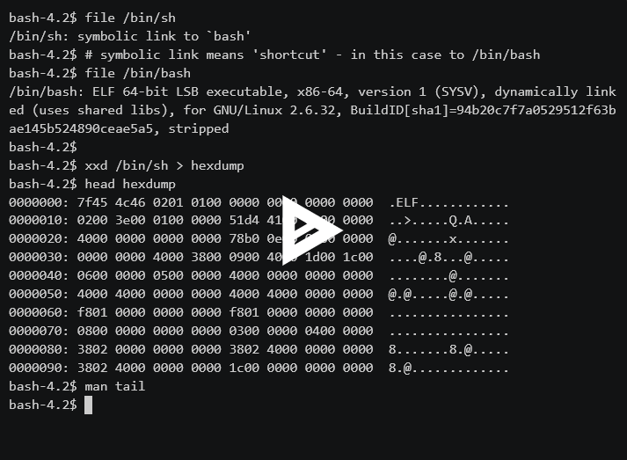
Exercises (solutions)
●
See demo:

Slide 64
Exercises (solutions)
●
less /usr/share/dict/words 300g /ing n n q

Slide 65
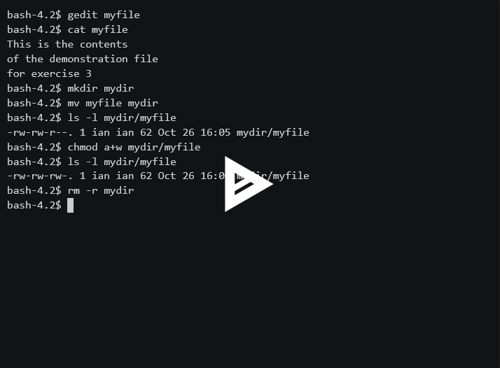
Exercises (solutions)
●
See demo:

Slide 66
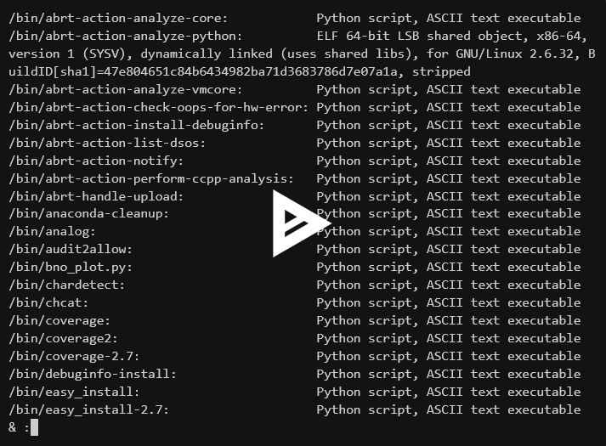
Exercises (solutions)
●
See demo:

Slide 67
Pipelines
■
Command | Outcome
cmd1 | cmd2 | Use the output of cmd1 as input to cmd2
cmd1 | cmd2 > file | As above, but write output to a file
cmd >> file | Append output to the file
cmd < file | Use file as standard input
echo 'string' | Output string
echo 'string' | cmd | Use string as standard input
cat file1 - | Output the contents of file1 followed by the contents of standard input
Remember:
This syntax is documented (briefly) in bash’s man page
Anything you can print to the screen can be sent to a file instead

Slide 68
Pipelines
■
grep is an example of a filter - a program that takes lines of input text and produces output text
In bash we can connect programs together with the pipe character, enabling more complex operations to be constructed
bash-4.4$ grep 'one' /usr/share/dict/words | grep -E '^.{5}$' Boone Jones …
Note that the second grep has no filename - by default it reads ‘standard input’

Slide 69
More pipeline programs
■
less will read from standard input by default - useful to buffer large outputs and allow you to scroll through it with my_command | less
sort sorts lines of data, uniq removes adjacent repeated lines
A common pipeline is sort | uniq, to remove all duplicates
wc counts characters, words and lines in the input
head and tail output the first and last lines of the data respectively
tr maps or deletes bytes (e.g. tr a-z A-Z to change lowercase to uppercase)
Notes:
All of these tools accept options to modify their behaviour

Slide 70
More pipeline programs
■
cut selects fields from columns of data (tab-delimited by default, but this can be changed with the -d option)
paste outputs corresponding lines from files. As a special case, paste - - converts each pair of lines in standard input into one line
fold splits each line into chunks of a particular length - it is particularly useful to get individual characters with fold -w 1
rev reverses each line of the input; tac outputs the input lines from bottom-to-top
Notes:
These are part of the GNU coreutils, which are officially documented in info pages (run ‘info coreutils’) rather than man pages

Slide 71
Standard input/output
■
In Unix, every program is given three default files to access:
Standard input (stdin), to read data from
Standard output (stdout), to write data to
Standard error (stderr), to print diagnostic messages to
These files are, by default, connected to the terminal - for example, running cat with no arguments will cause it to read standard input and wait for a line to be entered - each line read is then written to standard output and appears on screen. Typing Ctrl-D signals that there is no more input, ending the program.

Slide 72
Redirection
■
bash provides redirection operators <, > and >> to connect stdin and stdout to a file (> overwrites an output file whereas >> appends)
bash-4.4$ grep foo < /usr/share/dict/words > foobarwords bash-4.4$ grep bar < /usr/share/dict/words >> foobarwords bash-4.4$ wc -l < foobarwords 463
In a pipeline, the standard output of one program is connected to the standard input of the next

Slide 73
Providing standard input directly
■
The program echo writes its arguments to standard output, and can be used to provide strings to other programs as input
bash-4.4$ echo 'Hello, world!' Hello, world! bash-4.4$ echo 'Hello, world!' | xxd 00000000: 4865 6c6c 6f2c 2077 6f72 6c64 210a Hello, world!.
Note that a newline (0x0a) is included to terminate the line - this can be suppressed with echo -n
Notes:
Actually echo is part of bash rather than a separate program

Slide 74
Standard input as a file (nearly)
■
Most programs that accept input data can either be given filenames on the command line, or accept standard input
Standard input can be specified as a file argument either with the special file /dev/stdin, or often with a single dash - e.g. cat file1 - file2 outputs the contents of file1, then standard input, then file2
However, standard input is usually only read once - e.g. when data is streamed between programs it is not possible to go back to the beginning. Running cat - - will only output the input data once (the second time it reads from standard input there will be no further data)

Slide 75
Terminal output
◆
It is possible for a program to detect whether it is sending output to a terminal - this allows programs to modify their output:
bash-4.4$ ls file1 file2 file3 bash-4.4$ ls | cat file1 file2 file3
This is intended to make pipelining simpler, without detracting from usability

Slide 76
Pipelining exercise
■
File ‘testfile’:
1,dog
2,mouse
3,rabbit
4,mouse
Using the flashcards:
Create a command to list the animals alphabetically, without repeats
Now make a command that adds another animal to the bottom of the file
Notes:
James will hand out sets of flashcards to each pair and run this exercise

Slide 77
Modifying programs with environment variables
◆
As well as command line options, the behaviour of programs can also be affected by providing environment variables before the command:
bash-4.4$ (echo lower; echo UPPER) | sort lower UPPER bash-4.4$ (echo lower; echo UPPER) | LC_ALL=C sort UPPER lower
LC_ALL=C specifies that data should sort by byte value rather than character

Slide 78
More environment variables
◆
LESS=FRSX COLUMNS=50 man ls Automatically passes options -F, -R, -S and -X to less (which is called by man), and overrides the number of display columns to 50
POSIXLY_CORRECT=1 grep foo /usr/share/dict/words --color=never The POSIX standard specifies that options must come before other arguments - setting POSIXLY_CORRECT forces grep to consider --color=never as a filename (without it grep tries to be helpful instead of conformant)
Notes:
You don’t need to commit all this to memory - just know these options are possible and you can look them up later.

Slide 79
Terminal commands
■
Pressing Ctrl-C interrupts the current program, allowing you to escape from long-running programs, or those waiting for input, back to the shell
Ctrl-S tells the terminal to pause writing output (e.g. if it is going too fast to read) - note that this may include output from the shell! Press Ctrl-Q to get back to normal
Ctrl-D sends ‘end of file’ to the current program. If you are at a shell prompt, this may end your session
Ctrl-V escapes the next character, allowing you to insert e.g. a tab character into a command line
Notes:
These control sequences are configurable; you can see them with ‘stty -a’ (but bash overrides some of them)

Slide 80
Consolidation exercises
goo.gl/eimsfK
Exercises 1 - 4 should be possible with the material so far, but 3c is simpler with awk (up next)

Slide 81
sed and awk
■
Command | Outcome
sed 's/in/out/g' | Replace in with out in each line
sed '1,10d; 21,30d' | Delete lines 1-10 and 21-30
sed -i 'cmd' file | Edit the contents of file in-place
awk '{print $1, $2}' | Output the first two fields of each line
awk 'BEGIN{a=0} {a+=$1} END{print a}' | Add up the values of the first field on each line, and print at the end
awk 'NR == 2' | Output just the second line
awk '/^2020/{print $2}' | Output the second field of lines that start with 2020
Remember:
sed and awk commands should be wrapped in single quotes to protect them from bash
The awk man page is actually quite helpful

Slide 82
sed
■
sed is a small programming language that is commonly used to replace, insert and delete text in files or pipelines
Lines of the input are processed in turn by (possibly several) sed commands, which are of the form
[addr]X[options]
where X is a single-letter instruction - for example s to substitute or d to delete - and [addr] optionally describes which lines should be affected - this can be a line number, regular expression to match, or a range of lines

Slide 83
The s command
■
The substitution command s matches a regular expression in the input line and replaces it with either fixed text or backreferences to the matched text. The syntax is s/REGEXP/REPLACEMENT/FLAGS:
s/hello/world/ replaces hello with world once s/hello/world/g replaces hello with world everywhere it appears
s/([0-9]+) ([0-9]+)/\2 \1/ swaps two numbers (note that to use extended regular expressions you must provide the -E option to sed)
s/\w+/"&"/g quotes each word in the input - & references the whole match
Notes:
Most of the time, this is all you need to know about sed

Slide 84
Simulating other programs
◆
sed -n '/regex/p' is like grep 'regex' sed '/regex/!d' is also like grep 'regex'
sed -n '$=' is like wc -l
sed -E 's/([^:]*).*/\1/' is like cut -d ':' -f 1
sed '10q' is like head
sed '1h;2,10{;H;g;};$q;1,9d;N;D' is like tail (somehow)

Slide 85
awk
■
awk is another text processing language, suited to lines of data in multiple fields
An awk instruction consists of a pattern followed by an action (much like sed) - the pattern determines which lines cause the action to occur:
awk '/hello/ && /world/ {print "Found matching line:"; print $0}'
Here the pattern is /hello/ && /world/, which matches if the line contains hello and contains world, and the action (in braces) prints a string followed by the line
If the pattern is missing, the action happens on every line, and if the action is missing, the line is printed

Slide 86
Fields
■
awk automatically splits the input line into fields - by default fields are separated by whitespace, but this can be changed with the -F option
The first field is $1, the second is $2, etc. The whole input line is $0
awk also provides variables NF for the number of fields in the line, and NR for the current line number. This means that $NF is the last field in the line, $(NF-1) is the second from last, and so on
awk '$2 == 10' uses a pattern to print lines whose second field is equal to 10; awk '{if ($2 == 10) {print $0}}' does the same with an action

Slide 87
Strings
■
Literal strings in awk must be enclosed in double-quotes - for example:
awk '$2 == "***" {print "Success:", $0}'
This prints lines whose second field is exactly three asterisks (NB not a regex); "Success:" is a string we want to print so is quoted, whereas $0 is an expression that awk should interpret (and replace with the input line)

Slide 88
Expressions
■
awk provides operators and functions for common arithmetic and string manipulation tasks:
bash-4.4$ echo 3 17 | awk '{print ($1 * 256) + $2}' 785 bash-4.4$ echo sometext | awk '{print toupper(substr($1, 1, 5))}' SOMET
Expressions that are adjacent are concatenated as strings:
bash-4.4$ echo 7fffffff | awk '{print strtonum("0x" $1)}' 2147483647

Slide 89
if, for and while
◆
awk’s syntax is closely modelled on C, and it allows if statements (to execute instructions conditionally), for loops (typically to iterate a number of times) and while loops (to iterate until something happens), and others described in the man page
It is unusual to require these features - programs that are complex enough may be better implemented in a language with more features (e.g. Python)
To print each field on its own line:
awk '{ for (i = 1; i <= NF; i++) {print $i} }'

Slide 90
Consolidation exercises
goo.gl/eimsfK
Continue with exercises 1 - 4, try 6 and 10 if you have extra time

Slide 91
Day 2
https://youtu.be/XvDZLjaCJuw

Slide 92
Recap
Notes:
List the topics we covered yesterday. Wordsearch recap exercise (on flipchart/whiteboard)

Slide 93
bash the program
■
To save repeatedly typing commands, we can put bash command lines into a file, and get bash to execute it:
bash-4.4$ cat helloworld.sh echo "Hello, world!" echo "This is a shell script" bash-4.4$ bash helloworld.sh Hello, world! This is a shell script

Slide 94
The execute permission
■
To be able to run the script as ‘helloworld’ rather than ‘bash helloworld’, we need to set the execute permission with chmod +x helloworld
The execute permission is also used on directories, but in this case grants permission to access files in the directory. This is distinct from the read permission, which (like regular files) lets the user read the bytes of the directory, i.e. the list of filenames it contains

Slide 95
#!
■
From within bash, executable text files can be run as bash scripts, but to be able to execute it from other languages (e.g. Python or C) we must indicate that bash should be used as an interpreter to run the script:
bash-4.4$ cat helloworld.sh #!/bin/bash echo "Hello, world!" echo "This is a shell script"
Now when we run ./helloworld.sh, Linux itself executes the file by running /bin/bash ./helloworld.sh

Slide 96
Other interpreters
■
#! is also used for other scripting languages (Python, Perl, R, etc.)
For example for Python, scripts are run as e.g. /usr/bin/python ./script.py, so to make an executable Python script one may start the file with #!/usr/bin/python
However, to avoid hard-coding the location of the Python interpreter, it is also common to write: #!/usr/bin/env python
Here env is a program that looks for python in the same way as bash

Slide 97
Comments
◆
# is used to introduce a comment in bash - this means the #! line is simply ignored by bash (and for that reason # is used for comments in most scripting languages)
Comments can appear at the end of any command line, and last until the end of the line
The # character must be at the start of a word for it to count as a comment

Slide 98
Environment variables
■
Each process in Unix has environment variables - for example when we run LC_ALL=C sort we give the variable LC_ALL the value C in sort’s environment
The environment is otherwise passed down from bash - we can see the current environment variables by running env with no arguments
Standard environment variables include HOME, which contains the user’s home directory, and PWD, which contains the current working directory
To refer to the value of an environment variable in bash, use $varname: bash-4.4$ echo Home directory is $PWD Home directory is /home/user

Slide 99
$PATH
■
An important environment variable is PATH, which is a colon-separated list of directories that are searched for programs:
bash-4.4$ echo $PATH /usr/local/sbin:/usr/local/bin:/usr/sbin:/usr/bin:/sbin:/bin bash-4.4$ which sort /usr/bin/sort
Here which looks for files /usr/local/sbin/sort, /usr/local/bin/sort, and /usr/sbin/sort, before finding /usr/bin/sort. bash and env perform the same search when running sort

Slide 100
Modifying variables
■
We can add a new directory to PATH in bash by assigning the new value:
bash-4.4$ PATH=/home/user/bin:$PATH bash-4.4$ echo $PATH /home/user/bin:/usr/local/sbin:/usr/local/bin:/usr/sbin:/usr/bin:/sbin:/bin
Note that there must be no spaces around the = sign. Here we have used the previous value of $PATH in the assignment, so that we can still find system programs. Any programs in /home/user/bin can now be run without needing to provide a file path

Slide 101
Shell variables
■
New variables can be defined in the same way, but by default they do not form part of the environment - these are useful within shell scripts
bash-4.4$ datadir=/home/user/data bash-4.4$ cat $datadir/records.db | sort > $datadir/records.sorted
A variable can be placed into the environment by marking it with the export command - e.g. export datadir. This only needs to be done once - being exported is a property of the variable rather than its current value. bash also allows export with assignment (e.g. export datadir=/home/user/data)

Slide 102
Double quotes
◆
An unusual feature of bash is that variable expansion occurs before the command is split into arguments. Double quotes allow variable expansion but protect the contents of the variable from being interpreted further:
bash-4.4$ filename='./space name' bash-4.4$ rm $filename rm: cannot remove './space': No such file or directory rm: cannot remove 'name': No such file or directory bash-4.4$ rm "$filename"
Almost all of the time, variables should be within double quotes

Slide 103
Reading data from stdin
◆
The read command reads a line of data from stdin and stores the result in shell variables (terminal input shown in italics):
bash-4.4$ read mydata Hello, world bash-4.4$ echo '$mydata is:' "$mydata" $mydata is: Hello, world bash-4.4$ read x y z 304 68 -1270 bash-4.4$ echo "x: $x" "y: $y" "z: $z" x: 304 y: 68 z: -1270

Slide 104
Bug hunt
◆
Here is a shell script to display a file interactively. Find 2 bugs:
#!/bin/bash echo 'Please enter a file path:' read FILENAME echo "You entered '$FILENAME'. Displaying file contents..." cat $FILENAME

Slide 105
Reading arguments
◆
Arguments to shell scripts are stored in variables $1, $2, $3, and so on. $0 is the filename of the script (this mirrors the list of arguments used in C). The number of arguments is $#.
There is also a special variable $@, which expands to all of the arguments. Writing "$@" expands to a quoted list of all arguments, which is useful to pass arguments directly to another program
The argument list can be modified with the shift command (to remove arguments from the start of the list) or the set command (to set the argument list in its entirety)

Slide 106
Command substitution
◆
As well as substituting values of variables, bash allows substitution of the output of command lines:
bash-4.4$ echo There are "$(ls | wc -l)" files in this directory There are 4 files in this directory
Double quotes should normally be used, as with variable substitution. This doesn’t prevent use of double quotes in the command itself
Note also that trailing newlines are removed from the output of the command - here the output from wc -l is actually 4\n, but only the 4 is substituted

Slide 107
Subshells
◆
The following behaviour can be surprising: bash-4.4$ foo='initial value' bash-4.4$ echo 'new value' | read foo bash-4.4$ echo "$foo" initial value
bash implements pipelines by running each command in a separate process (called a subshell). Subshells cannot affect the original shell process, which is unfortunate for the read command - the variable assignment only occurs in the subshell. An alternative here is to use command substitution: bash-4.4$ foo="$(echo 'new value')"

Slide 108
Process return codes
◆
When a process ends, it reports an integer return code, which is typically used to indicate whether the program ran successfully. A return code of 0 means ‘success’; non-zero for either no success, something unexpected or user error - for example grep returns 1 if no match was found
In bash, the return code of the last command is stored in $?
bash can also condition on the exit status of commands - the syntax is
if command; then true-commands; else false-commands; fi
true-commands are run if command returns 0; otherwise false-commands are run

Slide 109
Tests
◆
A useful program to run in if statements is test (also used as [), which returns 0 or 1 for a range of common tests:
Any test command can also be written as [ command ] (spaces are important)
Command | Outcome
test -e filename | True if filename exists
test -d filename | True if filename is a directory
test str1 = str2 | True if the strings are equal
test -t 1 | True if file descriptor 1 (stdout) is connected to a terminal

Slide 110
Error handling
◆
The command set -e will cause bash to halt a shell script if any command doesn’t succeed
Standard error from a command can be suppressed with a redirection 2>/dev/null - here 2 is the file descriptor for standard error (0 is stdin, 1 is stdout) and /dev/null is a special file that ignores any data written to it
The && operator can be used as a shorter version of an if statement to ensure that later commands only happen if earlier ones succeed: cp "$filename" "$backupdir" && rm "$filename" If the copy fails (e.g. due to the disk being full), the original file will not be removed

Slide 111
for loops
◆
for loops in bash are constructed as follows:
for name in item1 item2 item3; do commands; done
commands are run with $name equal to item1, then again with $name as item2, and so on. This is more convenient with wildcards, for example
for filename in *; do echo "$filename"; cat "$filename"; done
Notes:
In fact bash supports the C-style for loop as well, e.g. for ((i=0;i<10;i++)); do echo $i; done

Slide 112
while loops
◆
while loops are structured very similarly to if statements, except the inner commands are run repeatedly until the condition returns non-zero
A common use of while loops is to iterate through the lines of stdin:
cat file | while read line do echo "$line" | fold -w 1 | sort | uniq -c done
Note that loops in bash are slow due to instantiating many processes; if possible use a single program such as awk

Slide 113
Other bash features
◆
bash is quite a large language - there are too many features to cover in a single session, but the man page contains details of all the syntax that is supported
Existing shell scripts are a good way to learn bash. The internet (particularly Stack Overflow) also has good answers to most common scripting questions
But in general, don’t write complex programs in bash - e.g. if you are using data that is not naturally formatted as text, or you require a lot of looping

Slide 114
Example: chisq
◆
The chi-square statistic can provide a measure of how non-uniform a distribution is - a common use case is to check character counts in a file
We can get counts using a pipeline such as: bash-4.4$ cat file | fold -w 1 | sort | uniq -c 13 A 15 B 20 C
The stats package R can compute the statistic, but wants a line of the form chisq.test(c(13,15,20))

Slide 115
Example: chisq
◆
bash-4.4$ cat chisq #!/bin/bash awk '{print $1}' | paste -s -d ',' | \ awk '{print "chisq.test(c("$0"))"}' | Rscript - bash-4.4$ seq 10 20 | ./chisq
Chi-squared test for given probabilities
data: c(10, 11, 12, 13, 14, 15, 16, 17, 18, 19, 20) X-squared = 7.3333, df = 10, p-value = 0.6936

Slide 116
Consolidation exercises
goo.gl/eimsfK
Try exercises 5 and 6 to practise writing shell scripts

Slide 117
Processes
■
Command | Outcome
gedit filename & | Launch editor as a background task
jobs | Show background tasks of this shell
top | Interactively show all processes
kill 32767 | Terminate process with PID 32767
kill -9 32767 | Force kill process with PID 32767 (danger)
nohup command & | Run a command that will not stop when the session is closed
fg | Move a background task back to the foreground
Remember:
Each process has a unique numerical PID (process identifier)
top can help you check that your processes are behaving correctly

Slide 118
Background tasks
■
Usually bash waits for a command to finish before prompting for the next - this is sometimes not useful, e.g. when running an editor
Ending a command with & causes bash to run a command in the background - e.g. gedit filename & opens a window and returns to the prompt
A program in the foreground can be stopped by pressing Ctrl-Z, and then restarted in the background by running bg. Conversely a background job can be brought into the foreground (where bash will wait for it to end) with fg

Slide 119
Processes
◆
File descriptors
PID
PPID
User
Working directory
Memory
cmdline (argv)
Environment
Code
Libraries
Kernel calls

Slide 120
Processes from the shell’s point of view
■
cwd
Environment
stdin
PID
cmdline (argv)
stdout
stderr

Slide 121
top
■
top is an interactive program that displays all processes running on the system (as well as some overall system information)
By default the display refreshes every 3 seconds, showing the processes currently using the most CPU time. The first column, PID, gives the process identifier, a unique number that Linux uses to refer to the process
Pressing h displays top’s help page, and q exits (much like less)
Other useful commands include u followed by a username to display only that user’s jobs, and O to select a different field to sort by (e.g. resident memory)

Slide 122
kill and signals
■
Processes that are misbehaving (perhaps stuck in a loop, or using too many resources) can be terminated by running kill with the PID as an argument (e.g. kill 12345)
By default this sends a signal SIGTERM to the process - Linux defines a range of different signals, described on the signal man page - run man 7 signal to read it
Usually SIGTERM is sufficient to stop the process, but badly behaved processes may not respond to this, in which case sending SIGKILL with kill -9 PID will kill the process without waiting for a response - this may cause problems if the process is unable to tidy up resources it has been using

Slide 123
Running things outside the terminal
◆
When you close the terminal, bash sends SIGHUP to all background processes the shell is running, which typically causes them to end
To avoid this, launch the program with nohup:
bash-4.4$ nohup ./myscript.sh & nohup: ignoring input and appending output to 'nohup.out'
This allows processes to keep running without needing to keep a terminal open, e.g. to run jobs overnight

Slide 124
The /proc filesystem
⧫⧫
Linux exposes information about running processes via a special filesystem located at /proc
For example, the environment of a process can be found at /proc/PID/environ as strings separated by null bytes. Only the user that started the process can read this file.
More details can be found in the /proc man page - run man 5 proc

Slide 125
Lunch

Slide 126
Unix security model
■
In a multi-user system, it is important that users are not able to interfere with each other’s work, but that users can collaborate when necessary
Unix permissions allow users to limit or grant access to files, but access to processes is generally limited to the user who started the process
To perform administrative tasks, Unix provides a special superuser account, usually called root. root is able to access all users’ files and processes, as well as perform system maintenance

Slide 127
Becoming root
■
There are two ways for a user to perform actions as root on a system:
Run su - root to switch user to root - this requires knowing the password for the root account, and starts a shell as the superuser
Run sudo command - this typically prompts for the user’s password (to avoid accidental usage) and runs command with superuser privileges. This way is generally preferred because it allows greater control over which users can run which commands - a file /etc/sudoers determines the commands available. Note that if a user is granted permission to run sudo su - root, they can switch user and perform any root action (but without needing root’s password)
Notes:
sudoers is immortalised in the alt text of https://xkcd.com/1343/

Slide 128
root powers
■
root can read and write any file on the system
root can change the owner of a file with chown
root can kill any process on the system
root can create new users
root can add or remove users from groups
root can run su to start a shell as any user, without needing a password
If the root account is compromised, the potential damage is nearly unlimited (at least to the compromised machine). Consequently, many system tasks set up a less privileged user to run as, so that security holes pose a lower risk

Slide 129
The setuid permission
⧫⧫
It is surprising that a program like sudo can exist - if a program can be written that grants access to a root shell, how can the system stop anyone from running it?
The solution is a special permission bit for executables called setuid that causes it to run as the owner of the file, regardless of which user is running it:
bash-4.4$ ls -l /usr/bin/sudo -rwsr-xr-x 1 root root 149080 Jan 18 2018 /usr/bin/sudo
The ‘s’ in the user permissions indicates that the program will execute as root. A malicious user is unable to write a setuid program owned by root.
Notes:
On Linux, shell scripts are not allowed to be setuid, because it’s very hard to make them secure

Slide 130
The setgid permission
⧫⧫
Analogously, the setgid permission causes an executable to run as the group it is assigned to (so has access to files controlled by that group)
On directories, the setgid permission causes files created in the directory to be assigned to the same group as the directory itself. Some systems allow directories to be marked as setuid to set the owner of files, but this is not the case on Linux
To grant the setuid or setgid permissions on a file or directory, use: chmod u+s filename chmod g+s filename

Slide 131
The restricted deletion permission
⧫⧫
Directories have a further special permission that prevents users from removing files in the directory that they do not own - this is used on /tmp to prevent users affecting each other’s temporary files:
bash-4.4$ ls -ld /tmp drwxrwxrwt 1 root root 4096 Oct 12 23:19 /tmp
This permission can be added to directories with chmod +t. On Linux it has no effect on files
Notes:
On non-Linux systems, it’s complicated: https://en.wikipedia.org/wiki/Sticky_bit

Slide 132
Setting up your environment
■
On startup, bash executes commands in a user-specific initialisation file found at ~/.bashrc
Common things to put in bashrc include:
Setting environment variables (e.g. to put a user-specific directory on $PATH)
Setting shell variables (e.g. increasing $HISTSIZE)
Shell functions - pieces of shell code that can be called like a shell script, without needing to be in a separate file - e.g. function cdp () { cd /net/project/work/user; }

Slide 133
Configuring shortcut keys
◆
bash’s input library, readline, is configurable to change the function of keys and key sequences
You can see the current key bindings by running bind -ps - note that e.g. Ctrl-A is denoted \C-a and Alt-A is denoted \ea (equivalent to Escape followed by A)
The F5 key typically sends the bytes corresponding to keys Escape, [, 1, 5, ~, so a macro can be bound to this key by running e.g. bind '"\e[15~": "echo hello world\C-j"' (note there is one single-quoted argument, containing double-quoted strings)

Slide 134
Useful shortcut keys
◆
Ctrl-R - search command history for a string (repeat to find older matches) Alt-. - insert final argument of previous command line Alt-3 2 x - insert x 32 times. Several commands can be affected by a numeric argument (e.g. Alt-2 Alt-. inserts the previous command’s second argument) Ctrl-Left Arrow, Ctrl-Right Arrow - backwards or forwards by a word Ctrl-K - kill (delete) everything on the line to the right of the cursor Ctrl-Alt-E - expand variables in command line (without executing) Alt-# - put a hash before the command line and enter it (so that it is in the history as a comment)

Slide 135
Exercise time
goo.gl/eimsfK

Slide 136
Installing software
■
Not every piece of software is pre-installed on your machine - you can add software to your system by installing it (which just means creating the necessary files in the right places). It is possible to build from source, but more commonly the OS will provide a package manager to install things
As well as this, attempting to run a program that is not installed may generate a message telling you how to install the program, or offer to install it for you, e.g.
bash-4.4$ Rscript The program 'Rscript' is currently not installed. You can install it by typing: sudo apt-get install r-base-core

Slide 137
Installing software
■
apt-get (for debian based linux distributions like ubuntu)
sudo apt-get install software-package-name
yum (for RPM based ones like redhat)
sudo yum install software-package-name
For more information, read this page https://www.control-escape.com/linux/lx-swinstall.html
Notes:
Installing software is done using the package manager for the linux distribution e.g. ubuntu uses apt-get. To install packages you need to be superuser so mostly you’ll need to put sudo in front of the command.

Slide 138
Installing python packages
■
Python (like many languages) has its own package manager, pip
You need to install pip (pip3 for python3) using standard software installation tools
sudo apt-get install python3-pip
then you can use pip for specific python packages. E.g. for python3:
pip3 install python-package-name
For more information, read https://packaging.python.org/tutorials/installing-packages/#requirements-for-installing-packages

